Slide 1
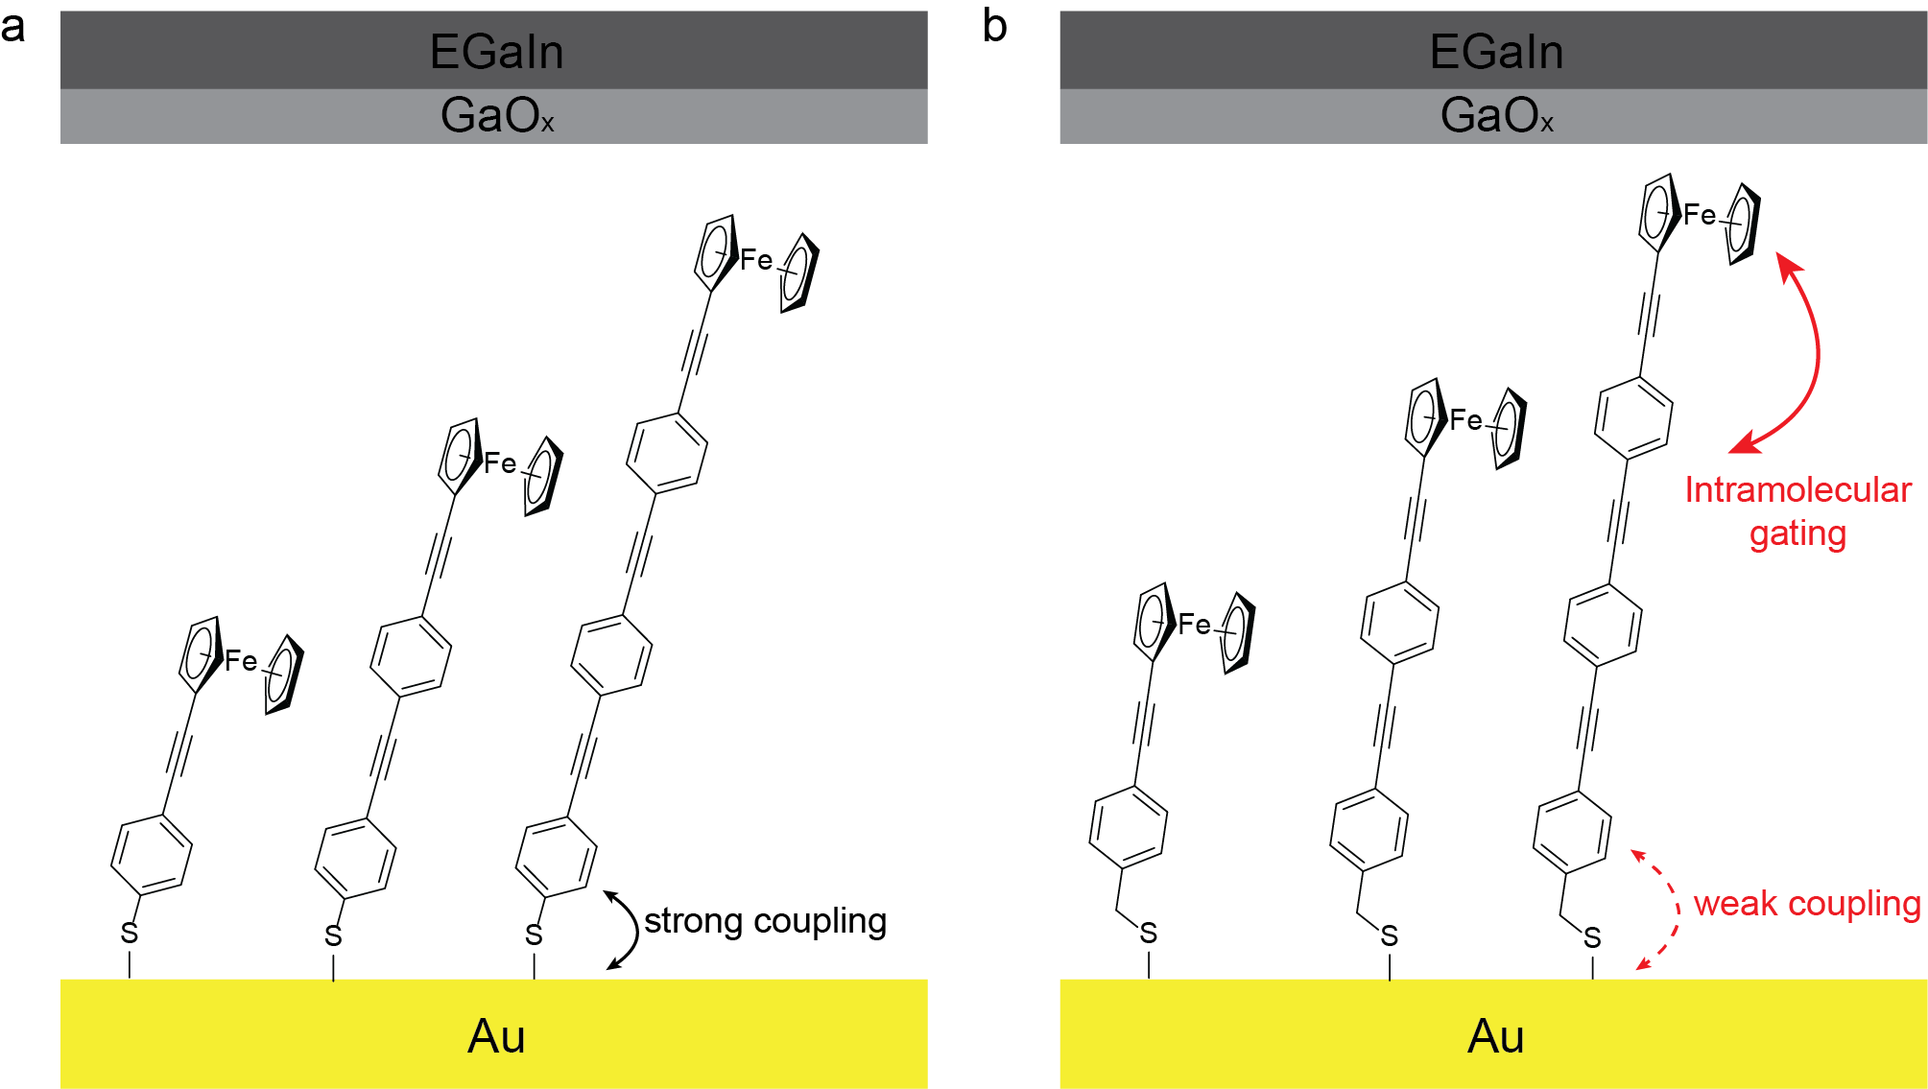

Slide 2
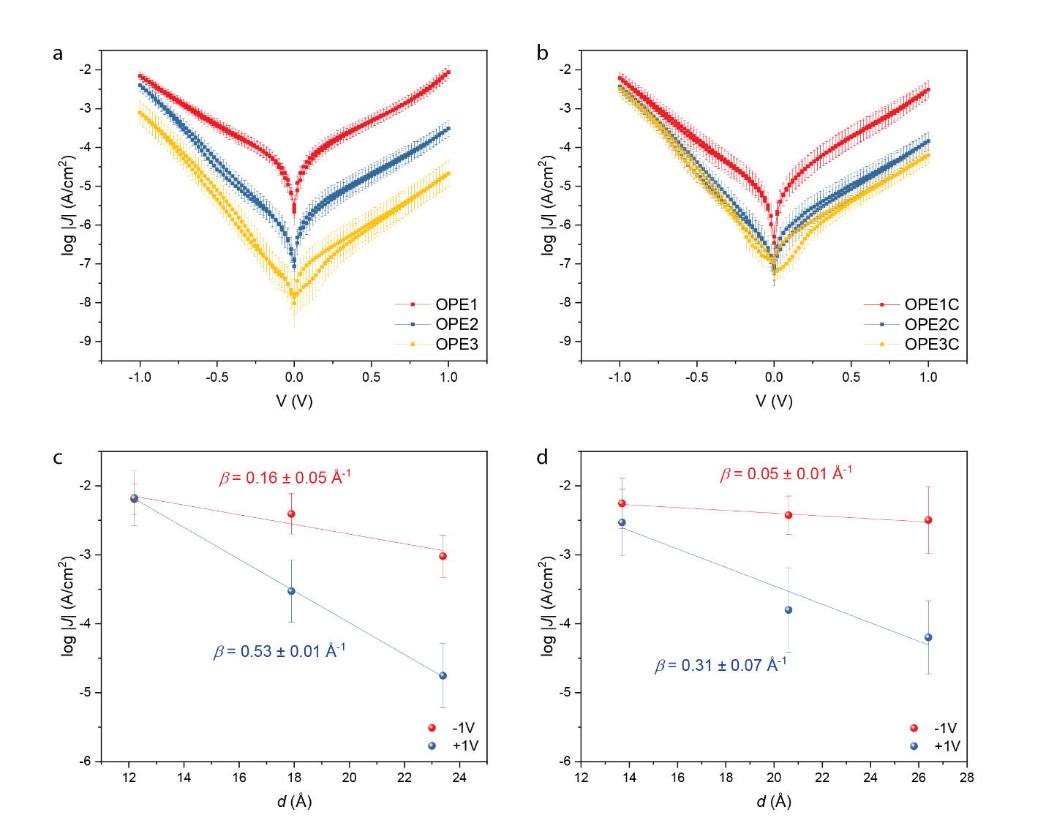
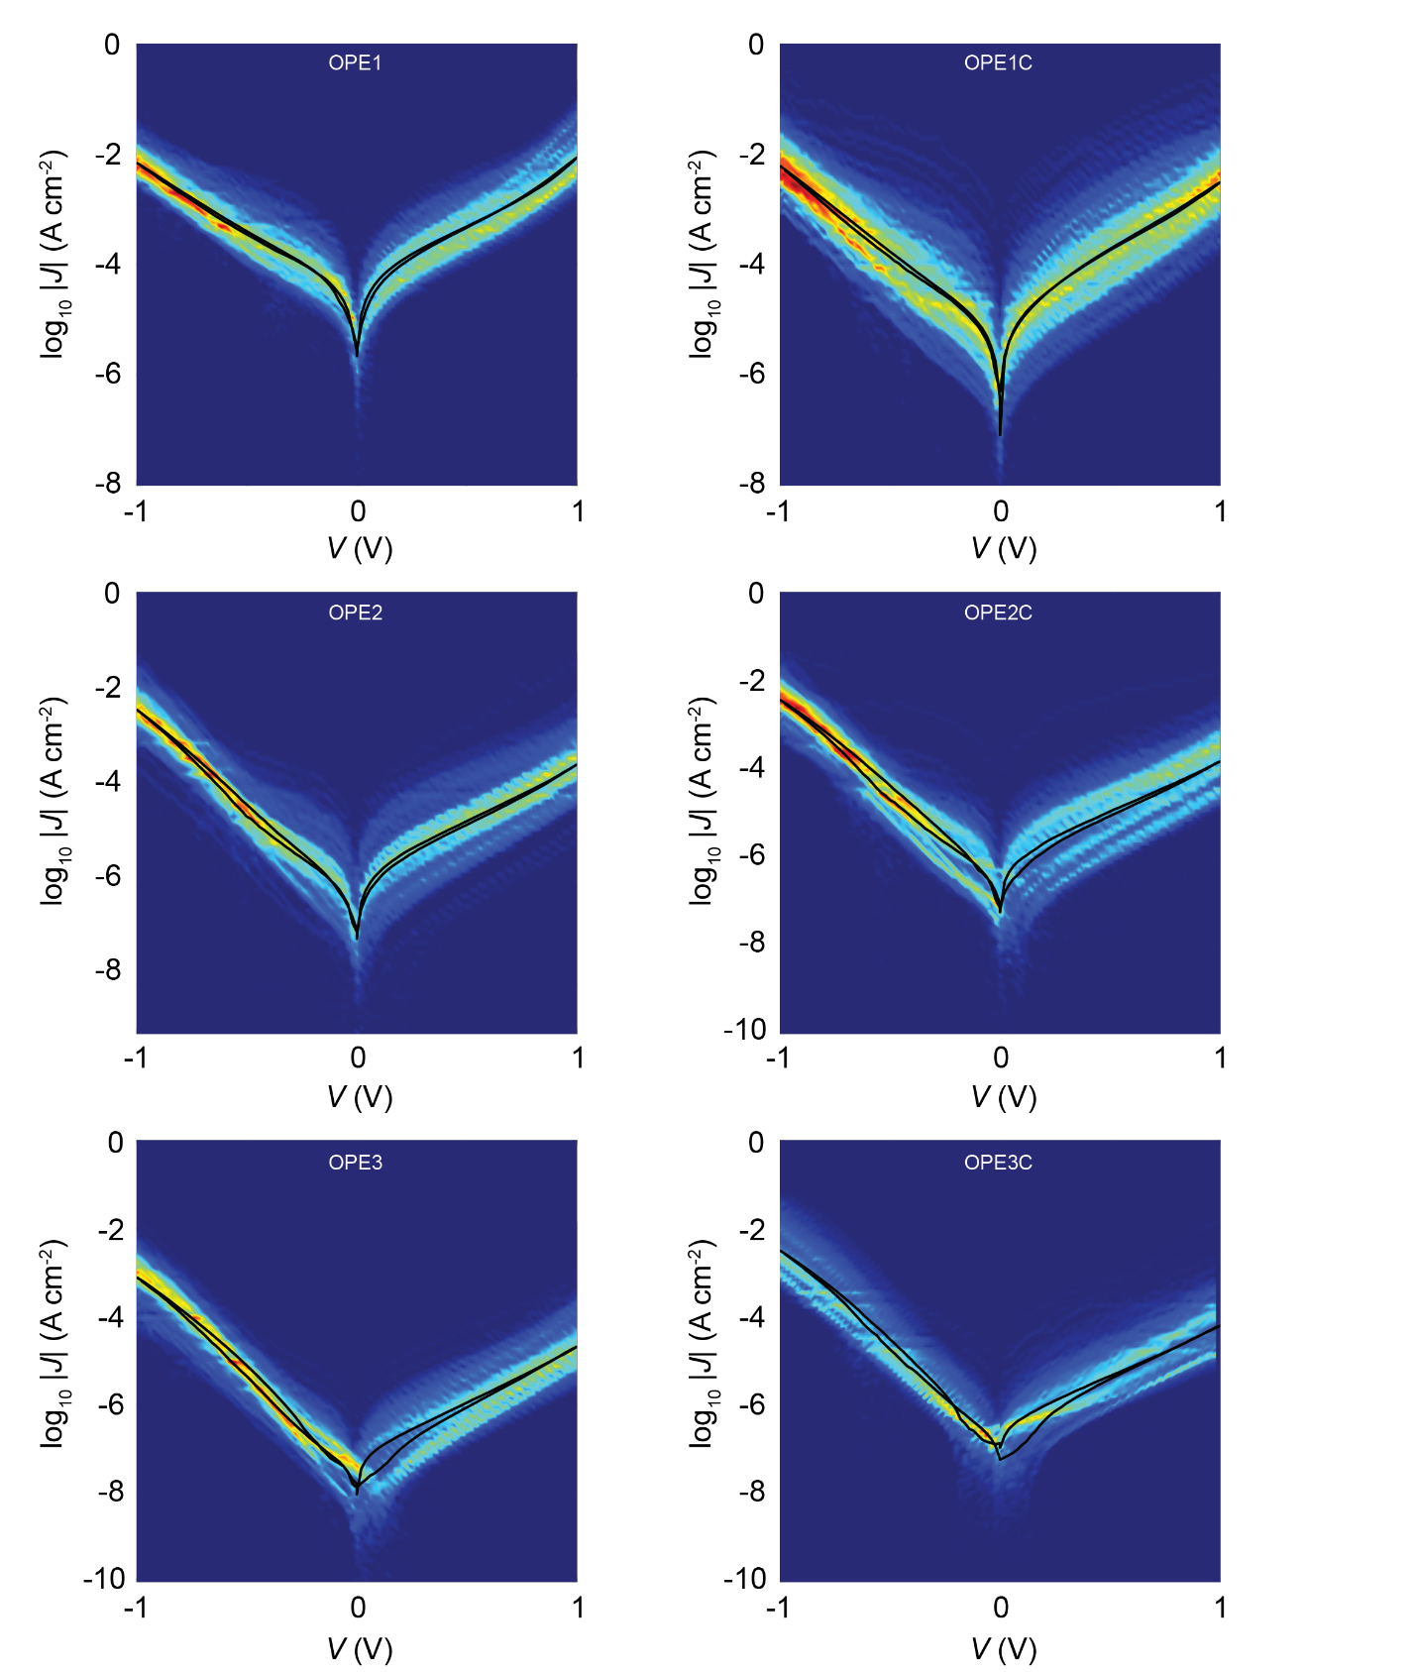
No real surprises here. Like the shortest molecules do not perform well because the SAMs are too defective, or simply that too little potential drops over the molecule. It is nice to see that beta in the incoherent regime is >> that beta in the coherent regime.
Differences in beta values could be due to differences in order and what not. But the differences are tiny. So I am a bit puzzled and cannot explain very well why beta for junctions with SAMs with CH2 is lower than for those junctions without CH₂

Slide 4
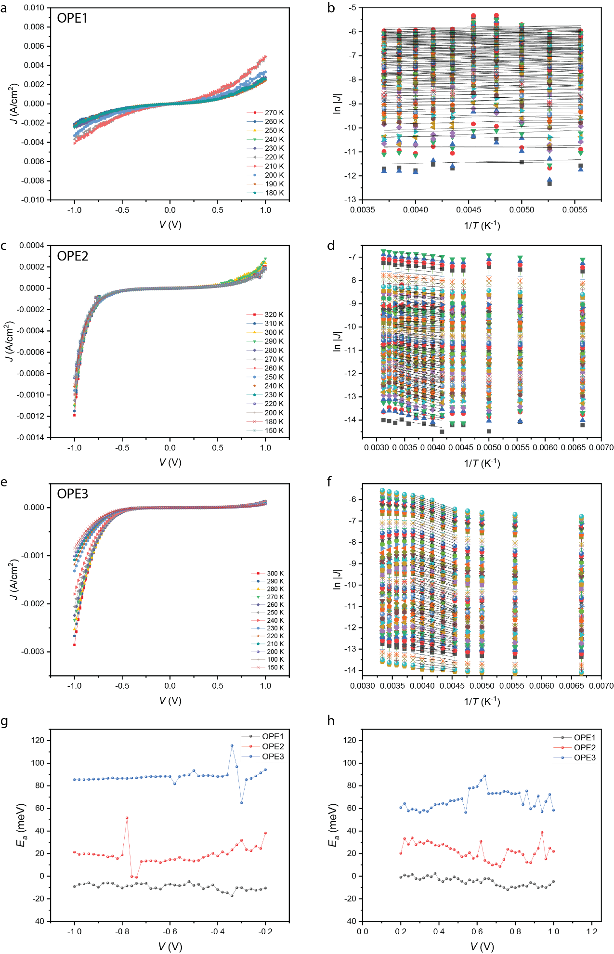
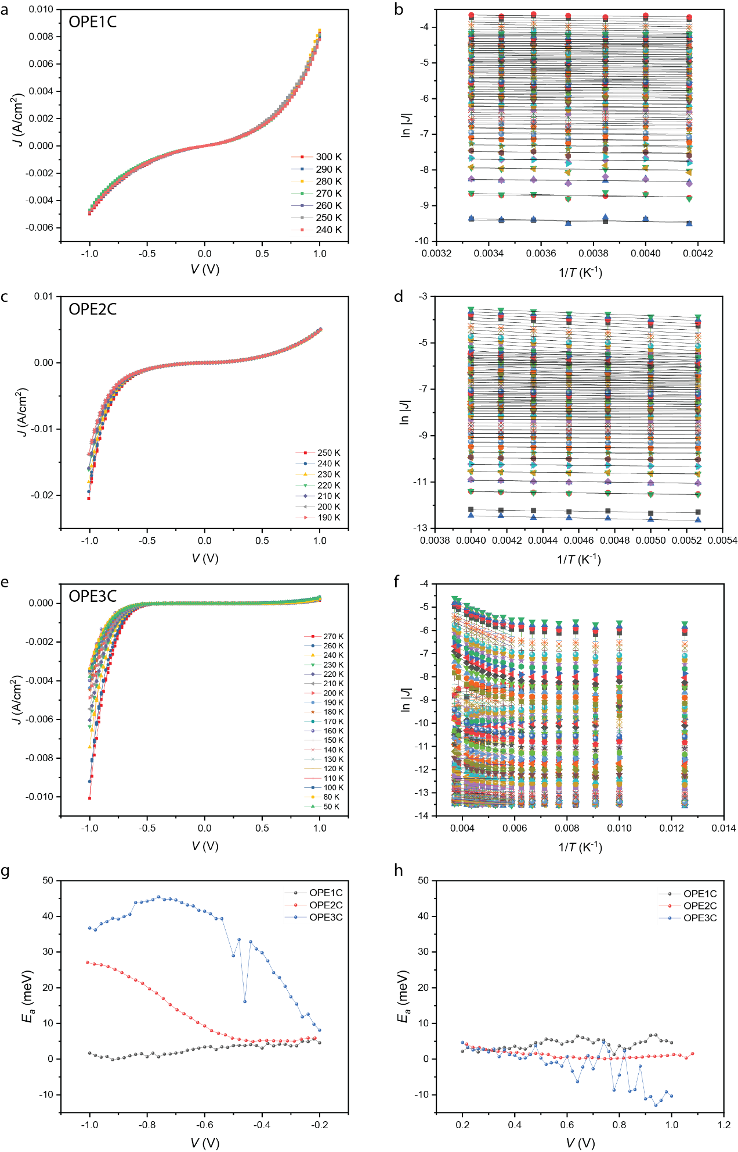
Activationless CT
Thermally activcated CT;
Inverted Marcus
Thermally activcated CT;
Onset of Inverted Marcus
Activationless CT

Slide 5
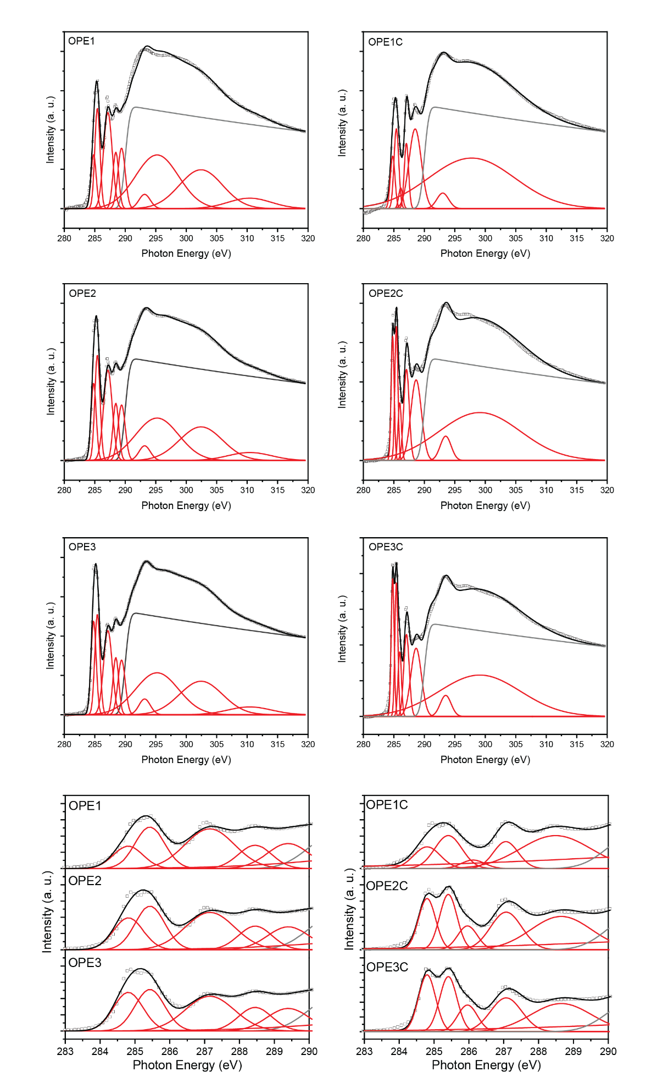
NEXAFS
Broad – strong coupling
Narrow – weak coupling

